Slide 1
5G Direction of Arrival System (DoA)
Ryan M Clayton
Sylvie Sorese
Dalton Mitchum

Slide 2
Goal
The design of an affordable system that detects the direction of arrival of a radio frequency (RF) propagating wave, in the ISM band, with the intention of eventually being used in a classroom setting.

Slide 3
Definitions, Acronyms, and Abbreviations
RF - Radio frequency
ISM - Industrial, Scientific, and Medical
DoA - Direction of Arrival
LNA - Low-noise Amplifier
SDR - Software Defined Radio
SPDT - Single Pole Double Throw Switch
SP4T - Single Pole Four Throw Switch

Slide 4
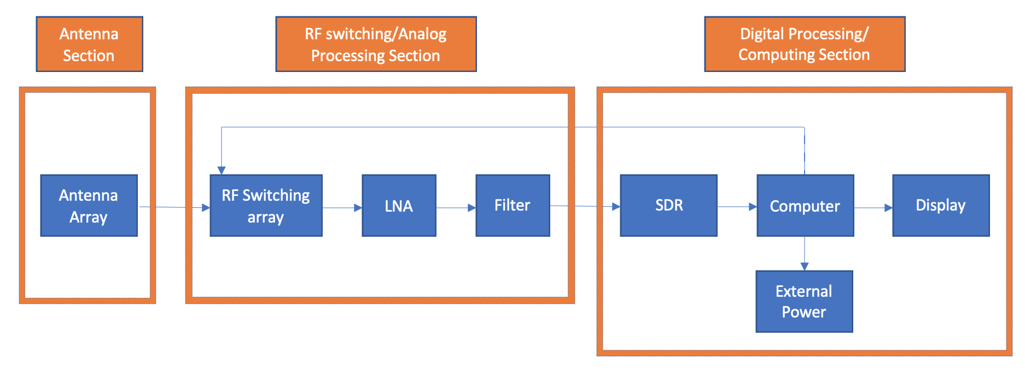
System Layout

Slide 5
Ryan Clayton
Acted as Scrum Team Member and RF Engineer
Researched Antenna Theory
Looked into corner antenna and amplitude modulation theory.
Researched Monopole Antennas for implementation.
Designed and Simulated 3-D Antenna Build
Utilized HFSS, ADS.
Constructed 3-D Antenna
Built using basic hand tools a rough construction that can be used for R&D and then eventually be 3D printed.
Assisted in Documentation Completion

Slide 6
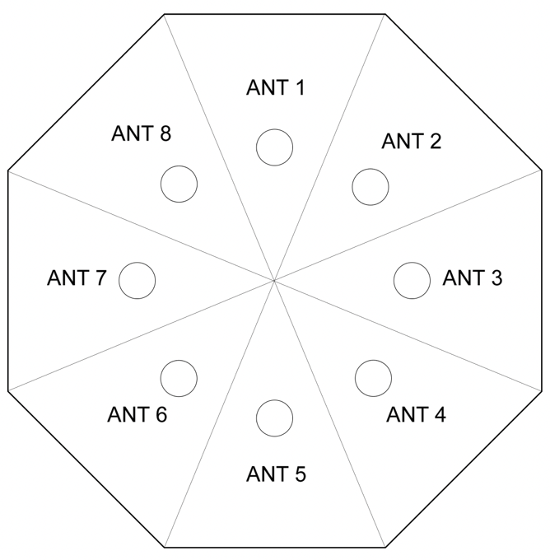
Antenna Array Design
Focus was set on the 3-D building and housing, rather than the antennas themselves.
Cornered design isolates each antenna from the others.
8 separate antennas give the computing portion of the design a good amount of distinction to work with.

Slide 7
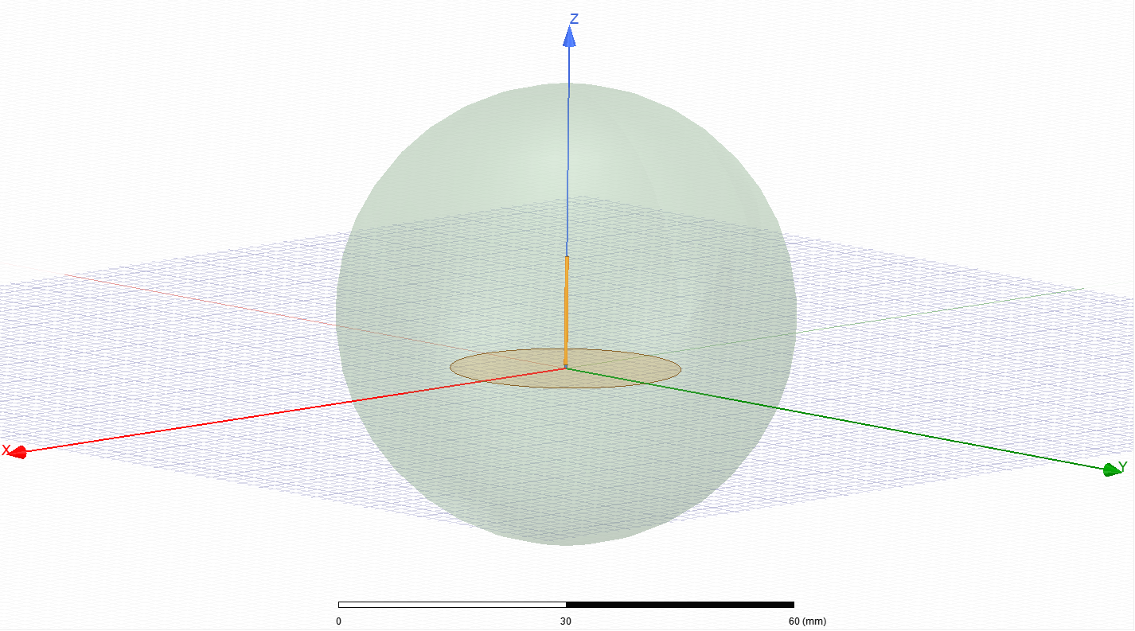
Model of Single 5G Antenna (Without Cornering)

Slide 8
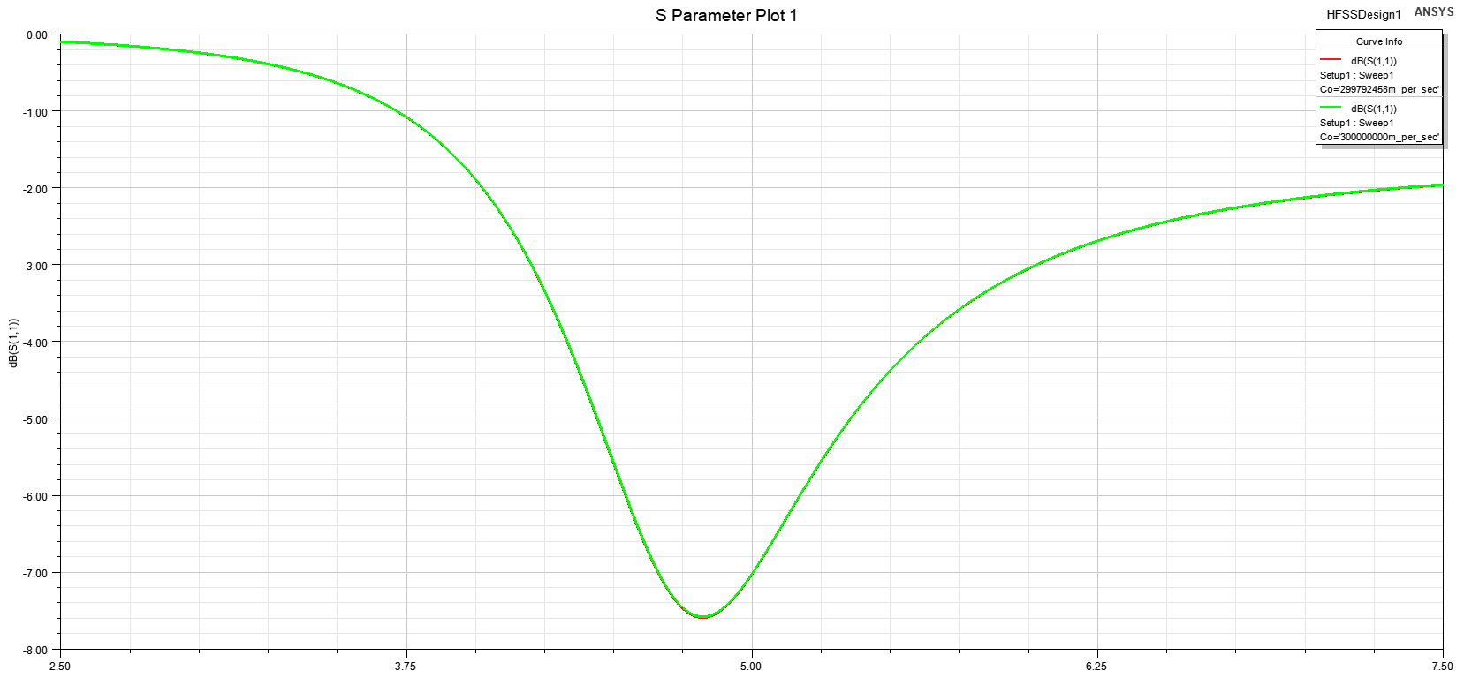
2.5 - 7.5 GHz Sweep of 5G Antenna Model (Without Cornering)

Slide 9
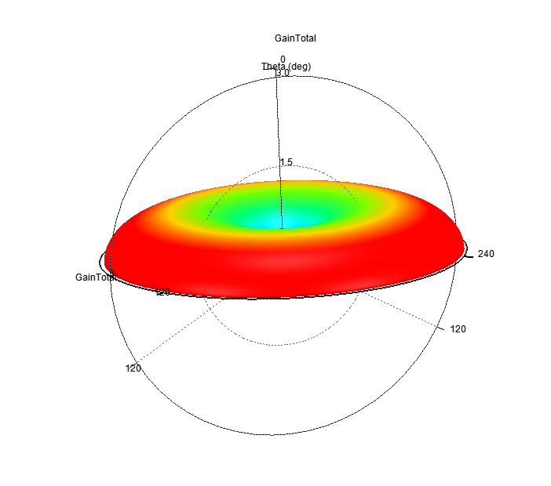
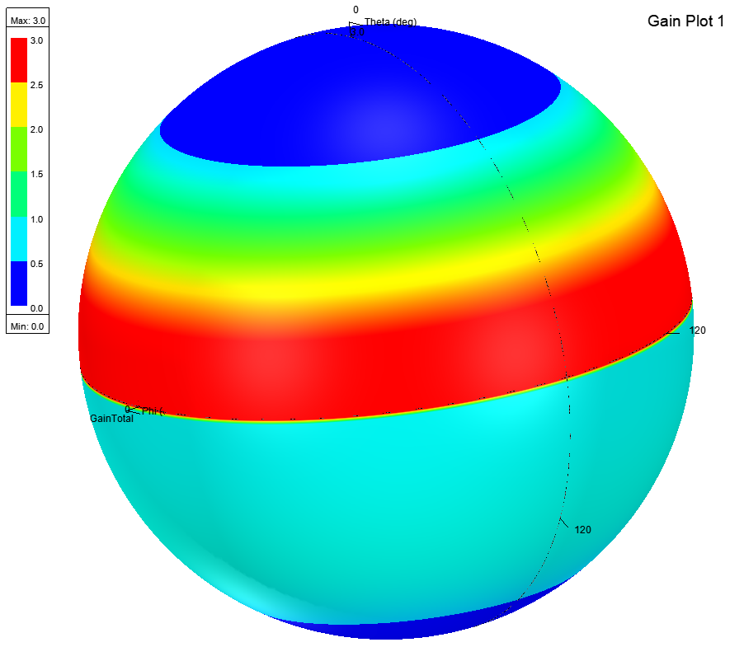
3-D Spherical Gain Plot of 5G Antenna (without cornering)

Slide 10
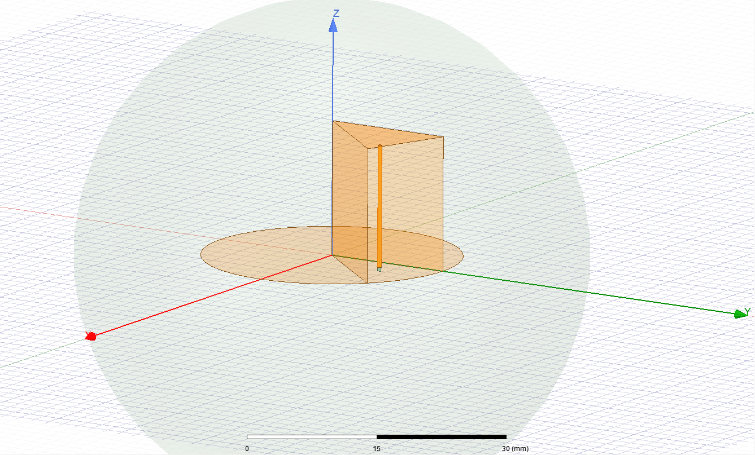
Model of Single 5G Antenna (Cornered)

Slide 11
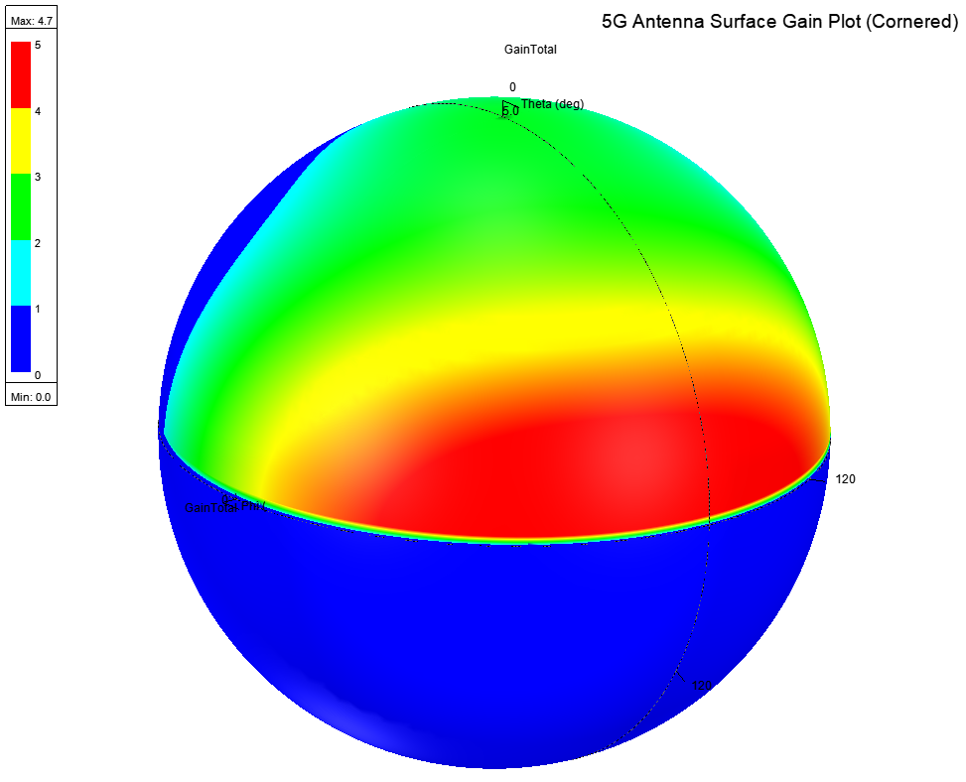
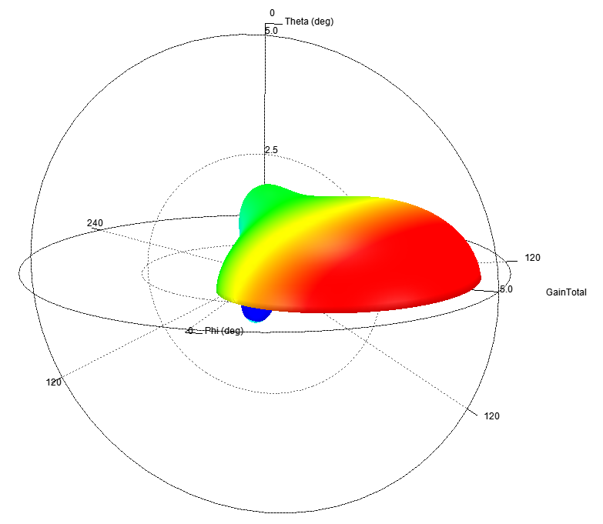
3-D Spherical Gain Plot of 5G Antenna (cornered)

Slide 12
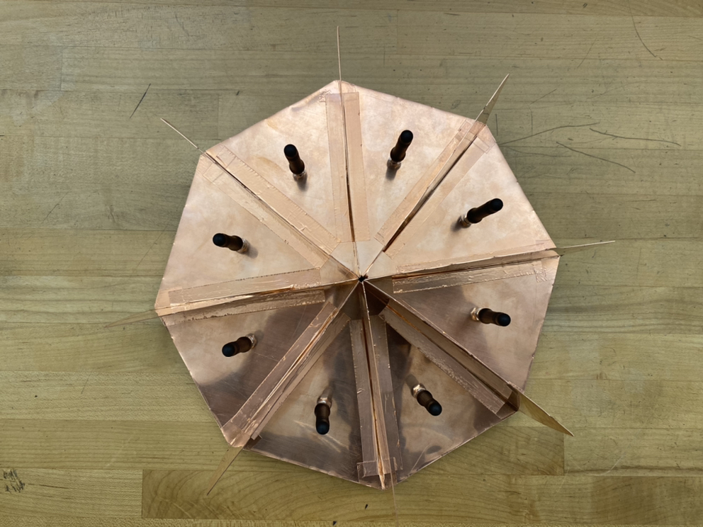
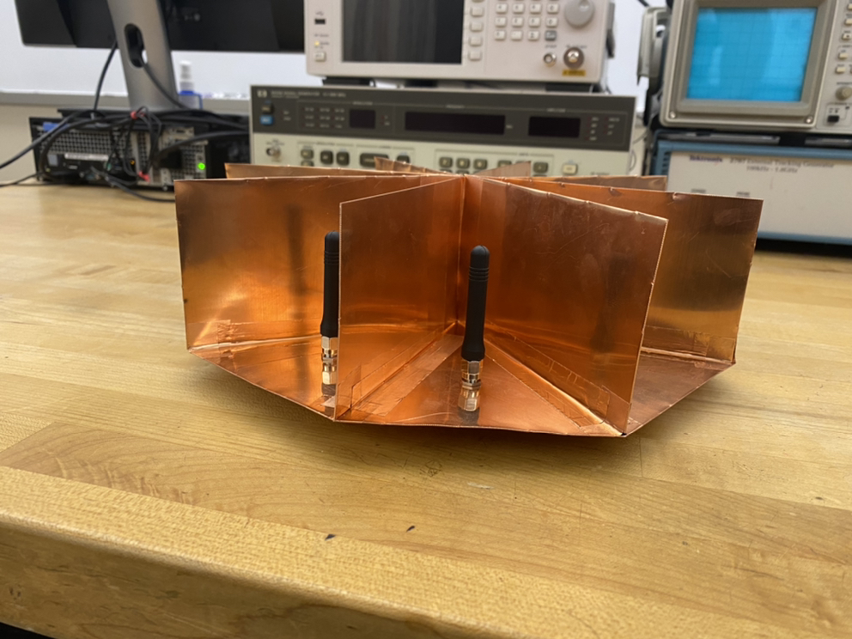
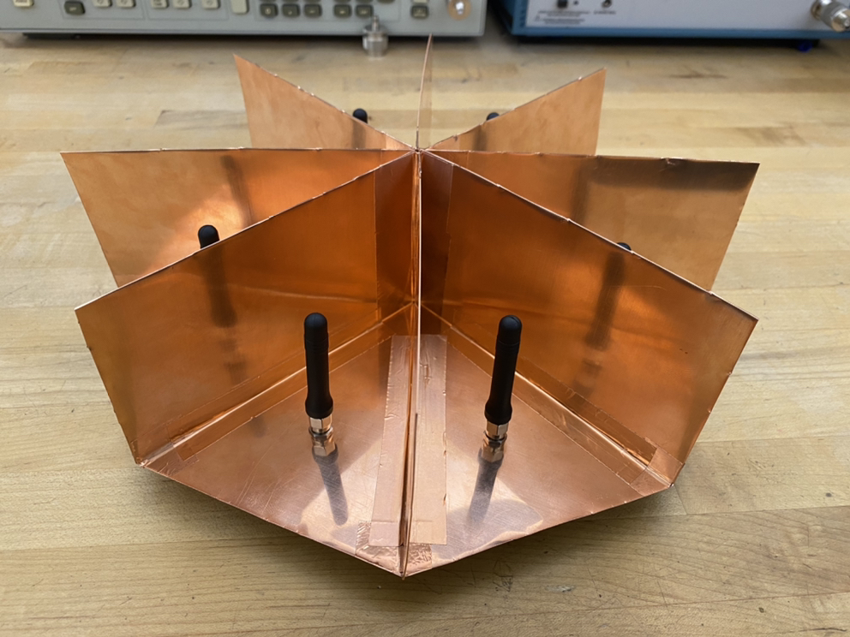
S-Parameters
S(1,1) = -42 dB
S(2,1) = -54 dB
S(3,1) = -65 dB
S(4,1) = -73 dB
S(5,1) = -66 db

Slide 13
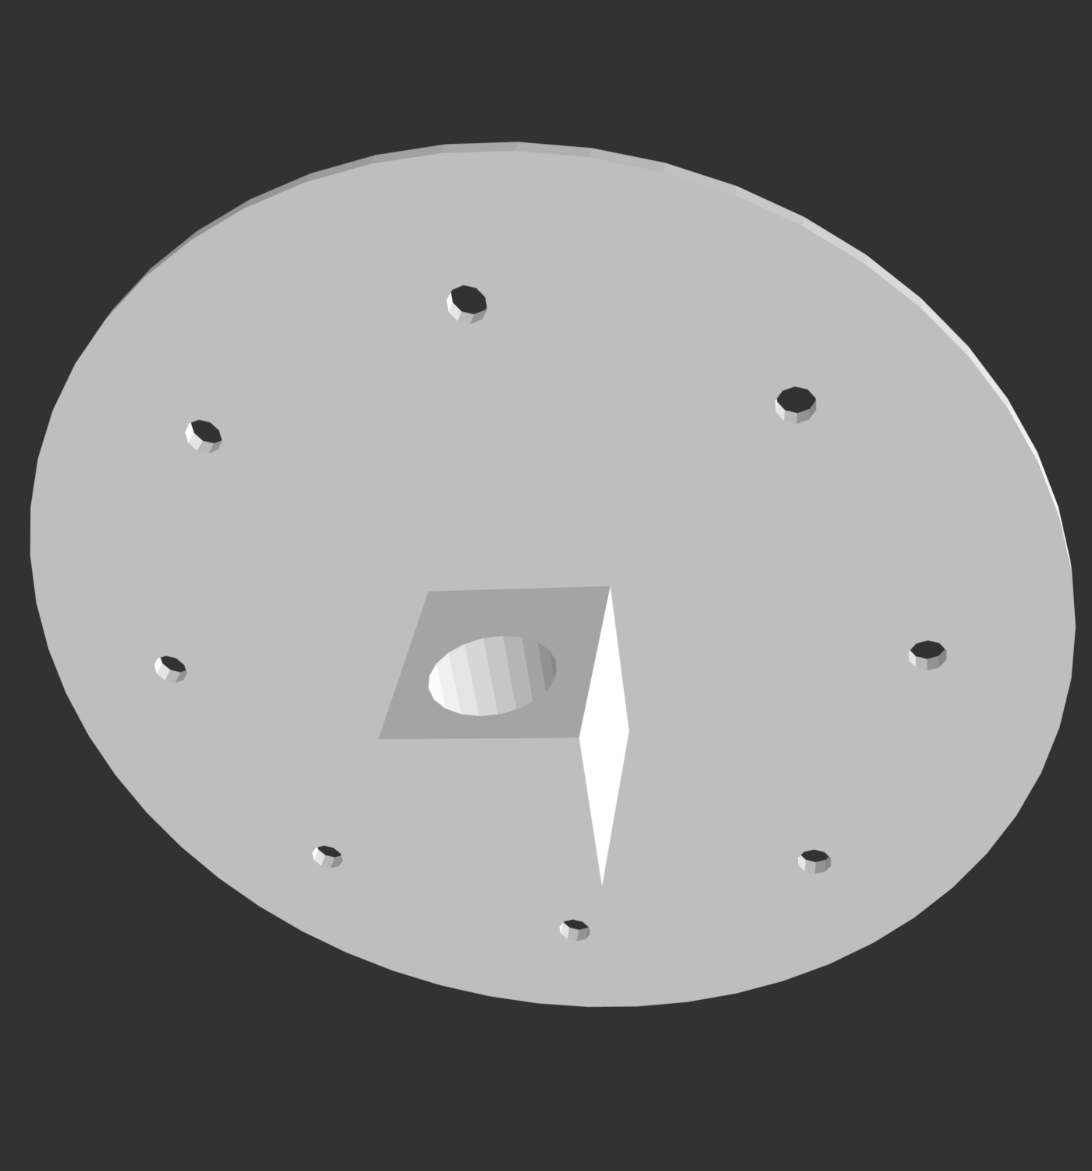
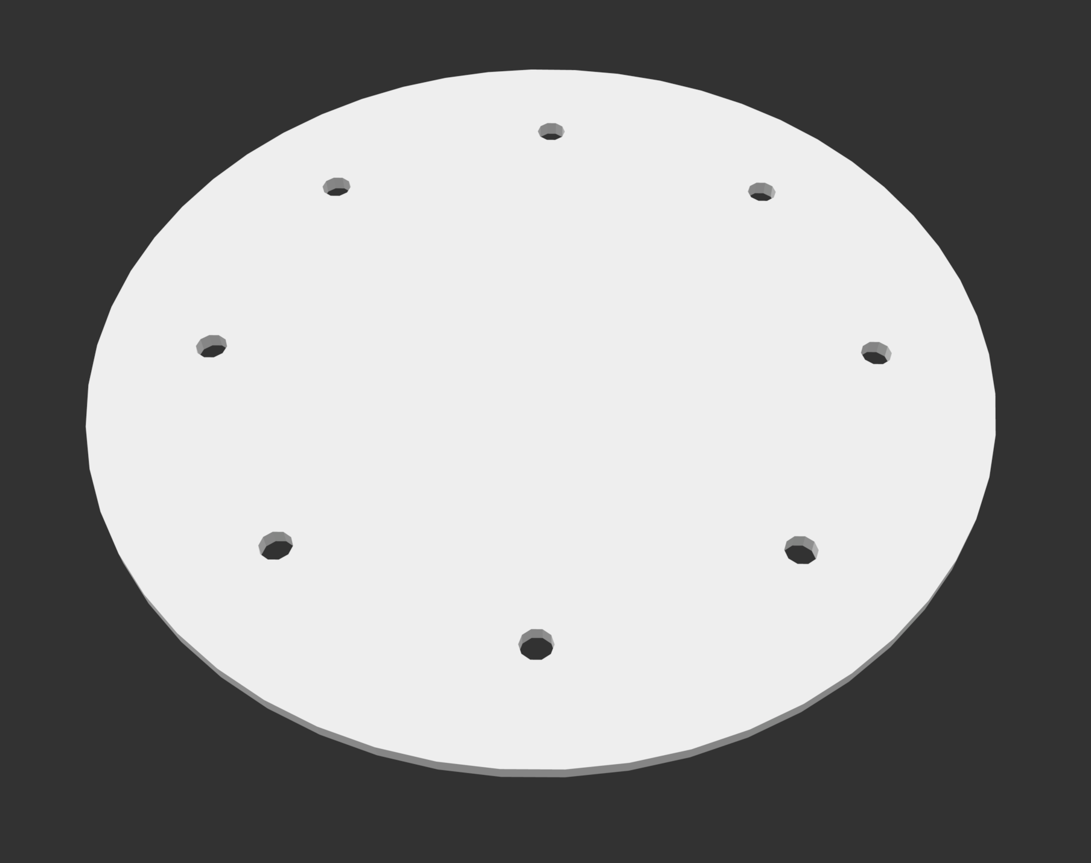
3D Mount Design for Antenna Chamber

Slide 14
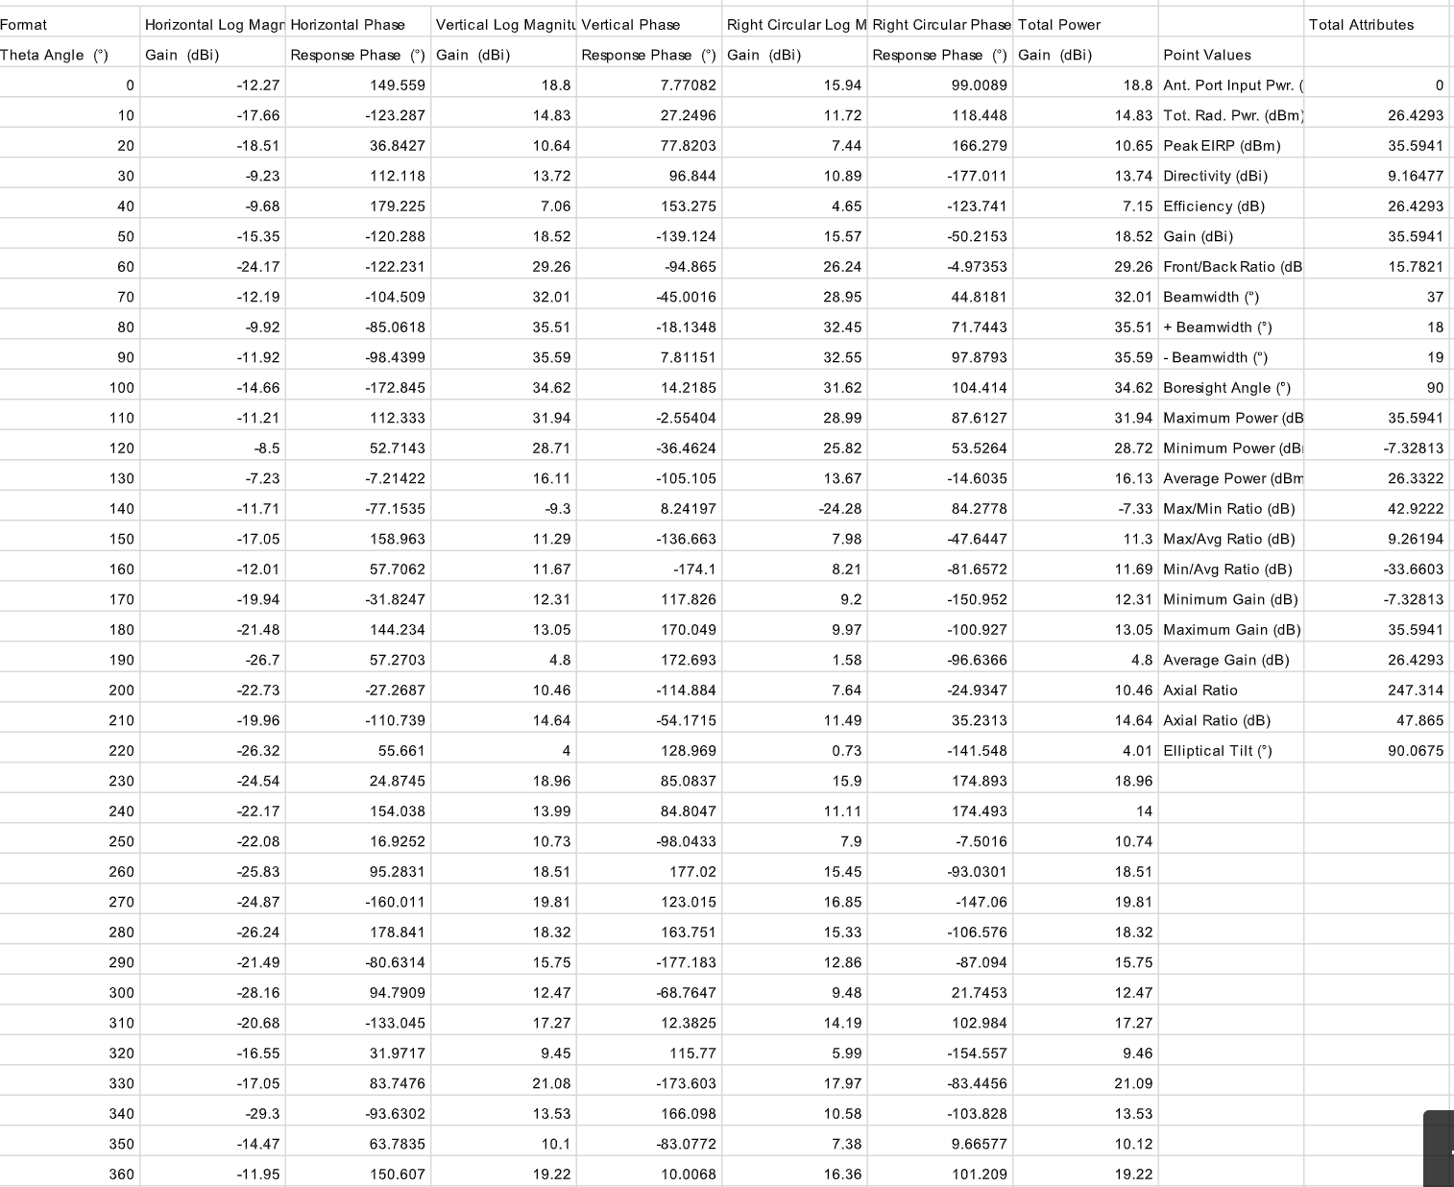

Slide 15
Sylvie Sorese
Acted as Scrum Team Member and RF Engineer
Researched RF DoA systems
Generate schematic for switch PCB design using ADS
Perform calculations to determine transmission line parameters
Perform simulations to retrieve S-Parameter behavior
Documentation
SRS, SDS, Test Plan

Slide 16
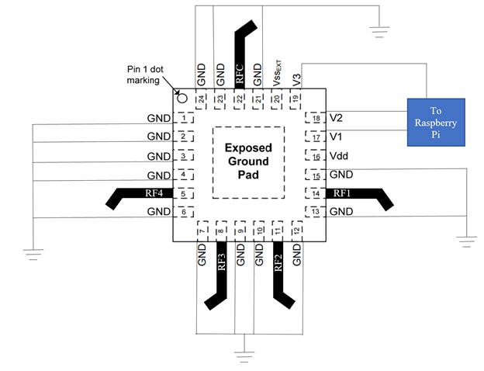
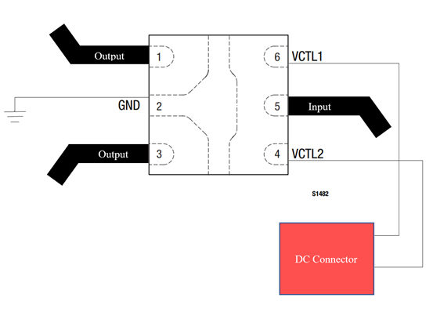
Switch PCB Layout Design
SPDT Switch PCB Diagram
SP4T Switch PCB Diagram

Slide 17
Background Information: S-Parameters for SPDT
S(1,1) - Reflection at Port 1
S(1,2) - Transmission from Port 1 to Port 2
S(1,3) - Transmission from Port 1 to Port 3
S(2,2) - Reflection at Port 2
S(3,3) - Reflection at Port 3

Slide 18
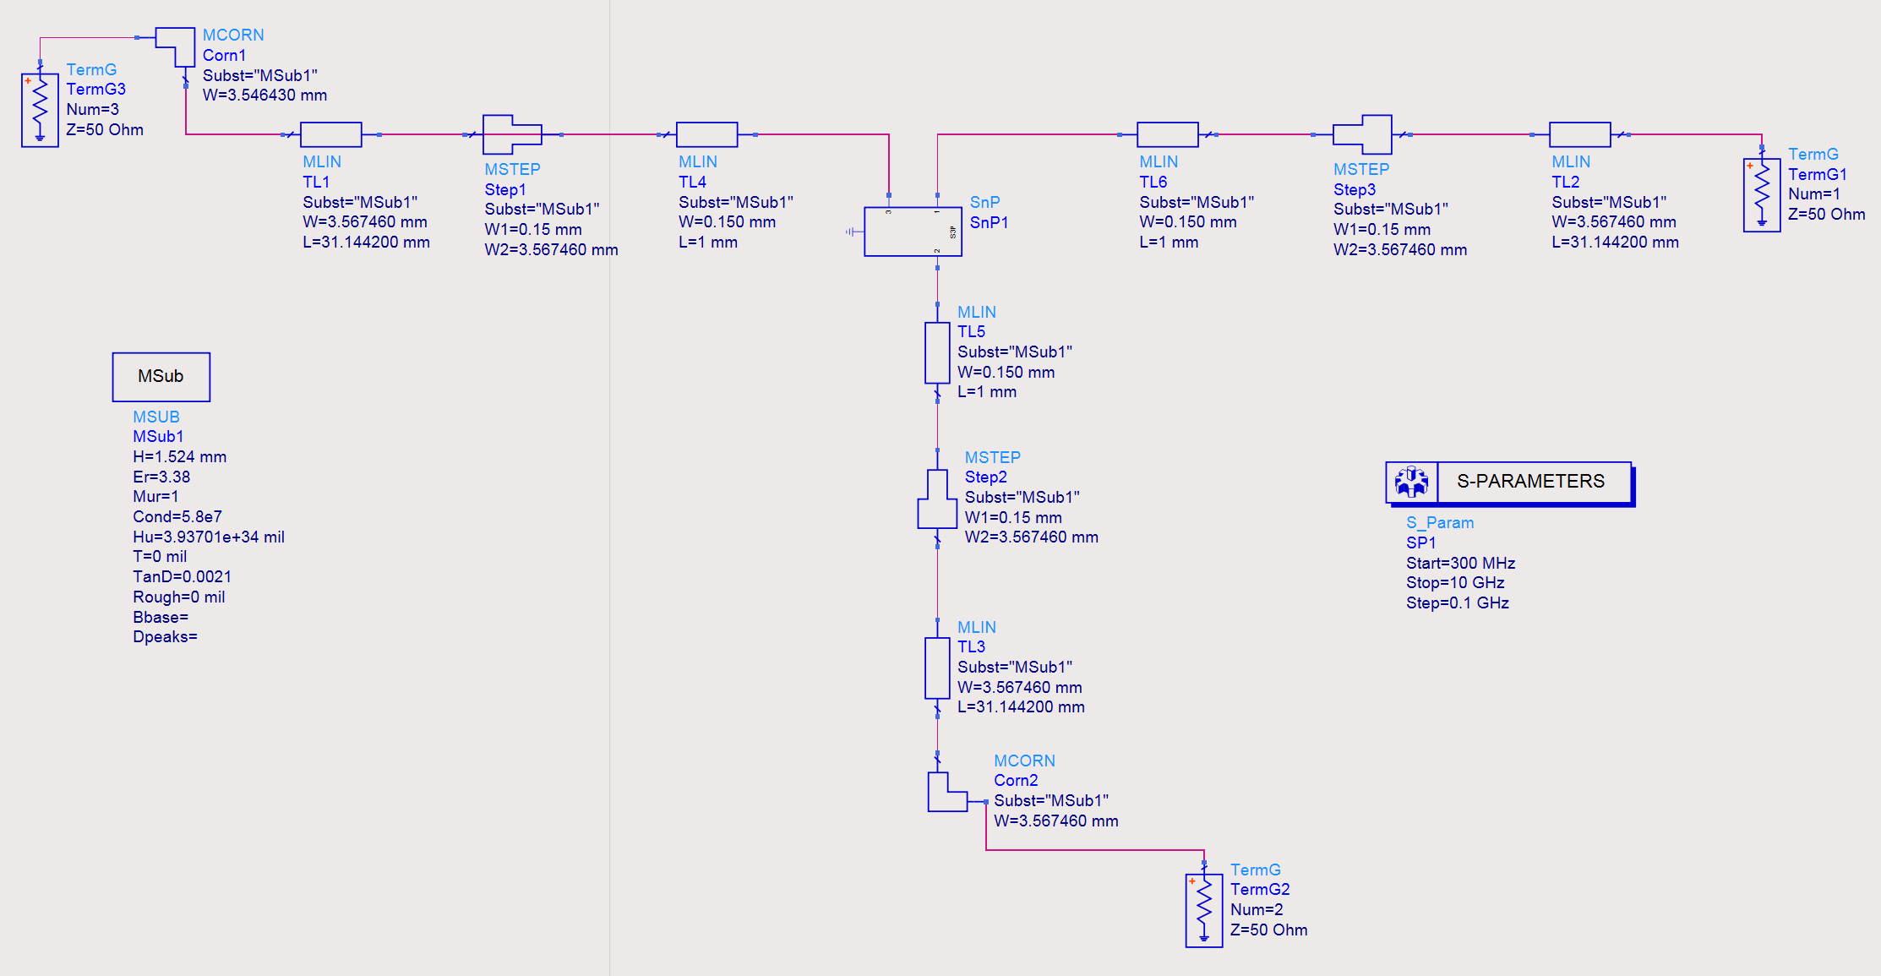
SPDT ADS Schematic

Slide 19
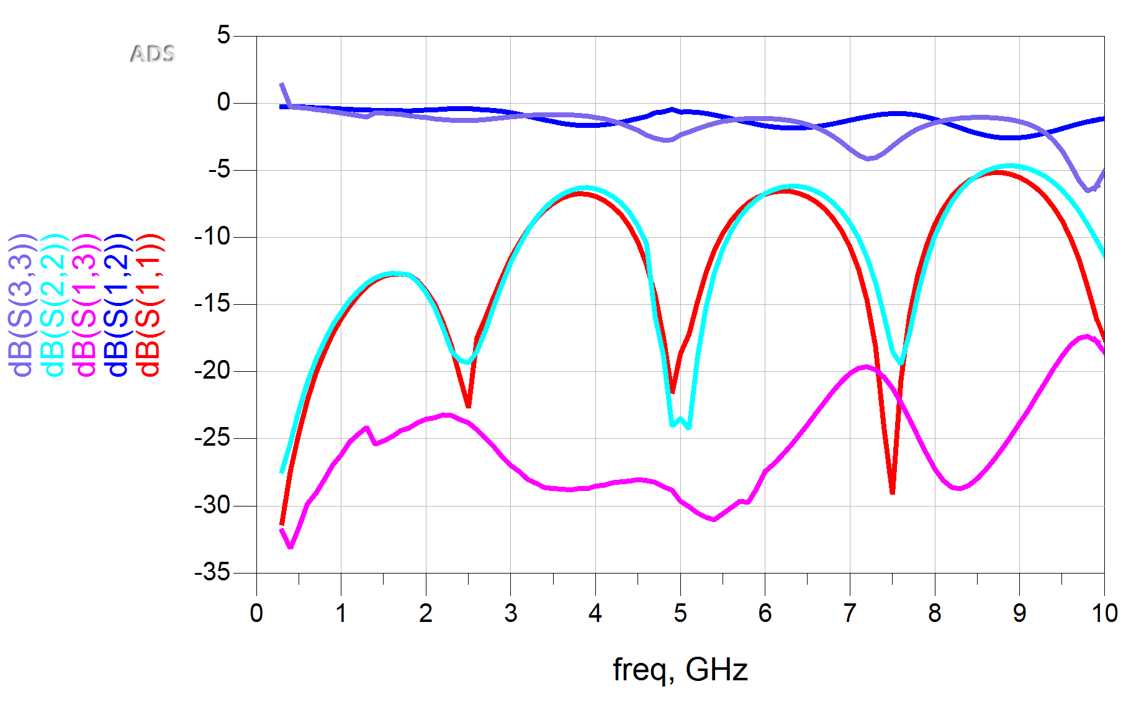
PCB Layout - SPDT Switch: Input 1 On

Slide 20
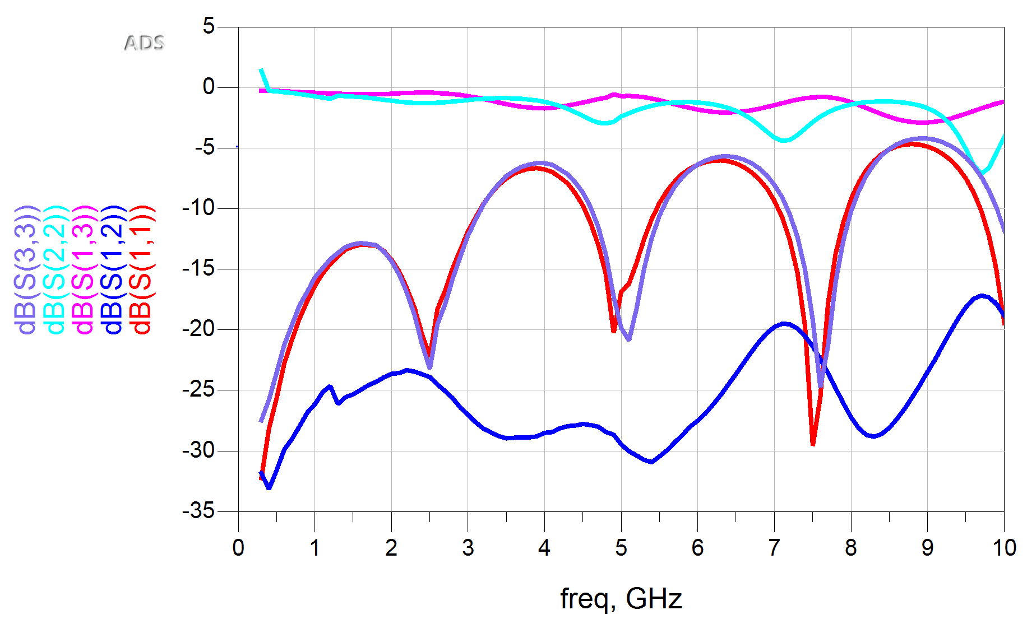
PCB Layout - SPDT Switch: Input 2 On

Slide 21
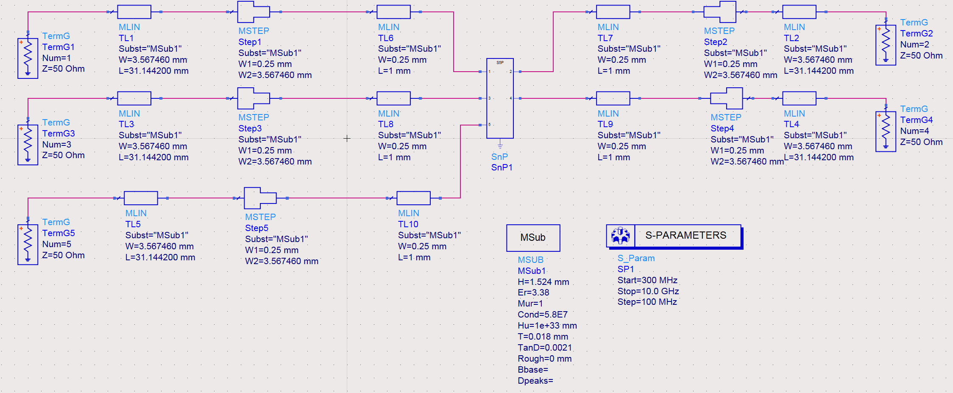
SP4T Switch ADS Schematic

Slide 22
Sprint Review
Put antenna in the anechoic chamber
Review antenna data
Continue PCB design and simulations

Slide 23
Looking Ahead - Spring 2021
Complete PCB designs
Create PCB boards
Get SDR Operational
Design Software interfacing for the antenna switching array
Design Computational Software for data interpretation of direction
Refine the antenna array and print a newer improved version

Slide 24
QUESTIONS?

Slide 25
THANK YOU

